Slide 1
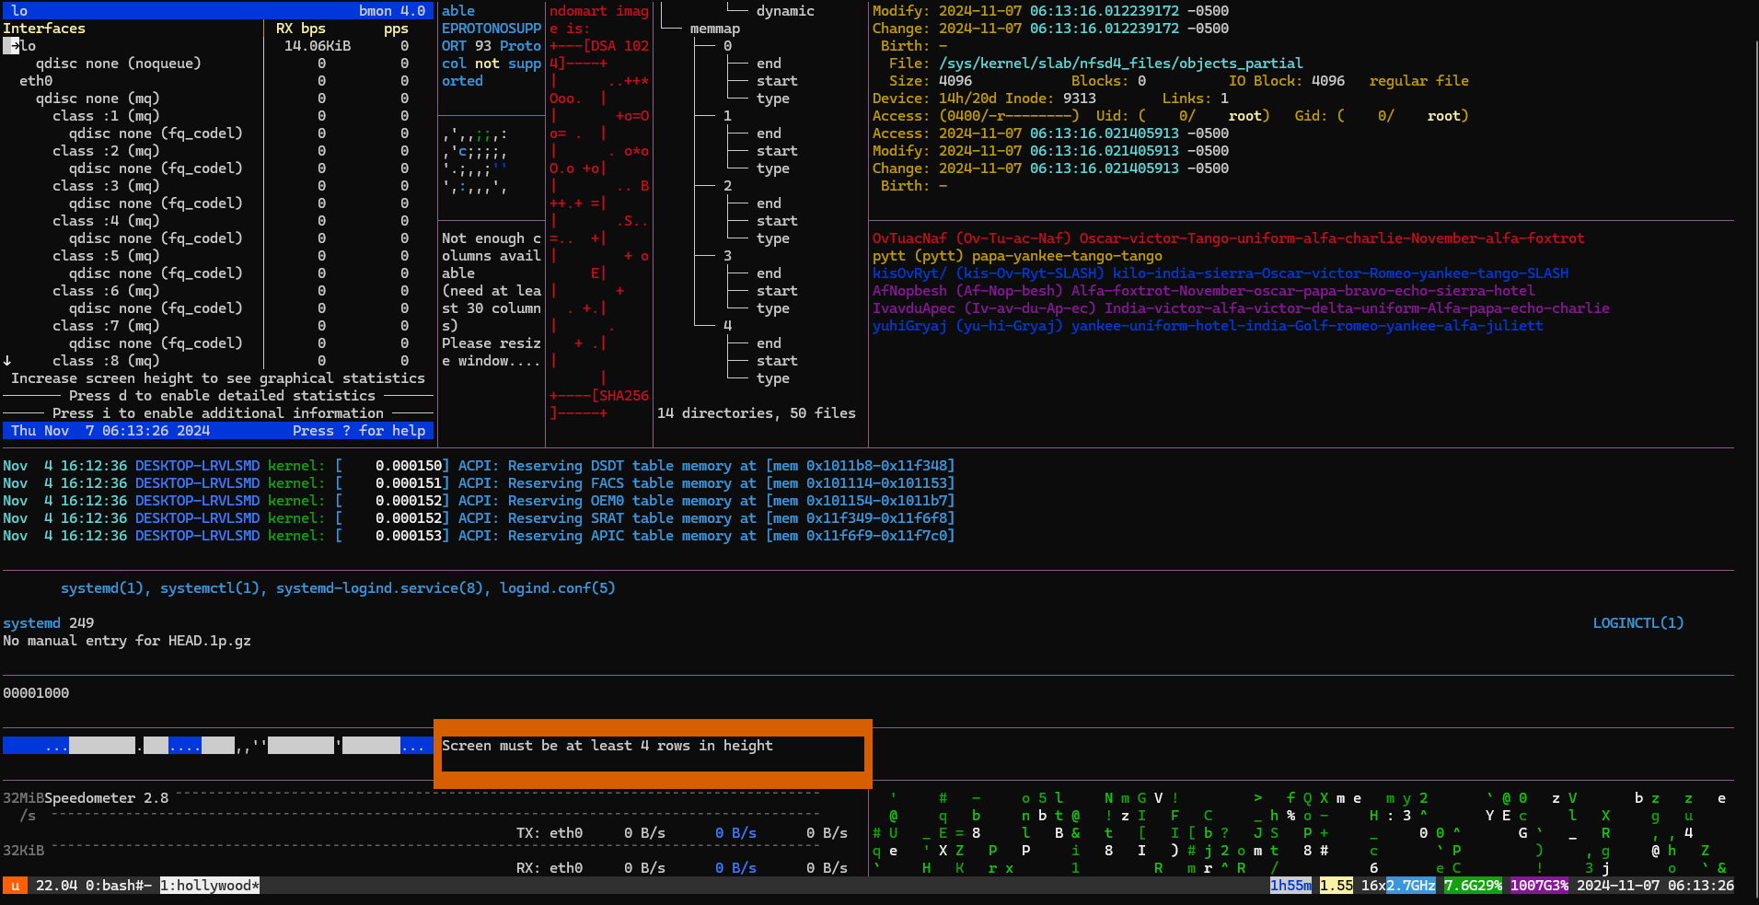
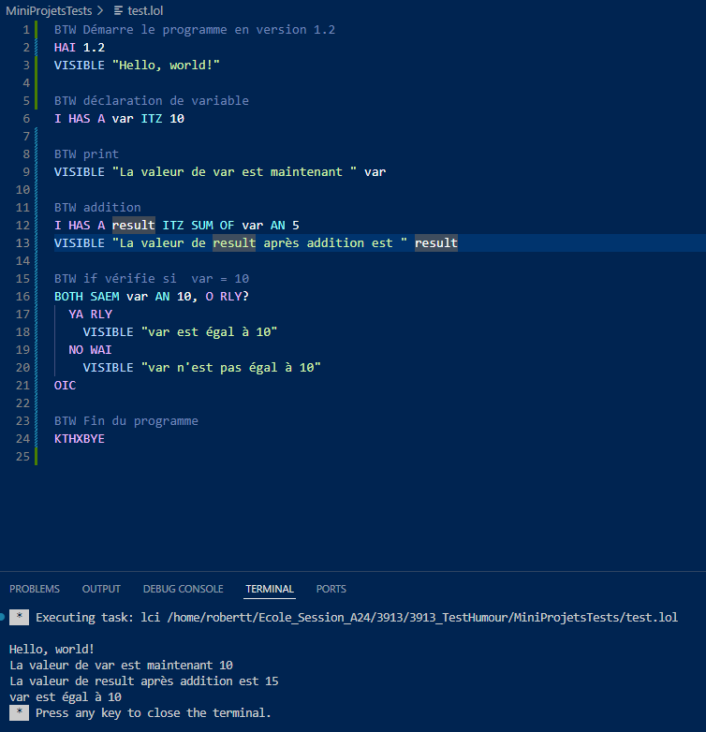
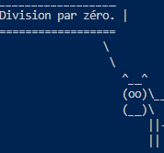
Test et humour

Slide 2
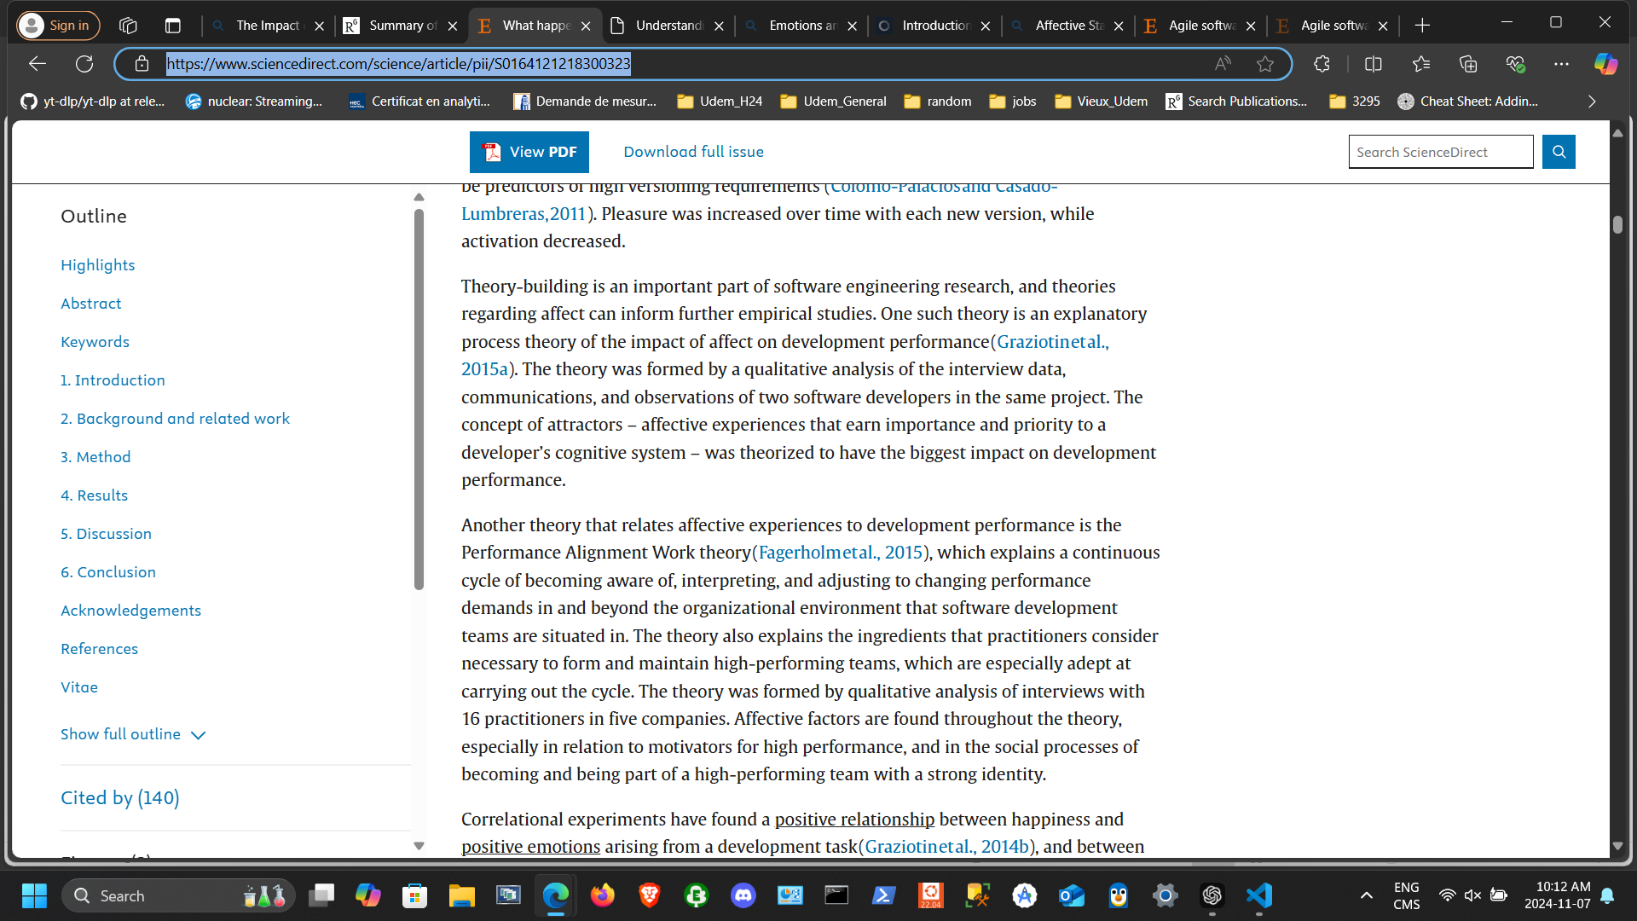
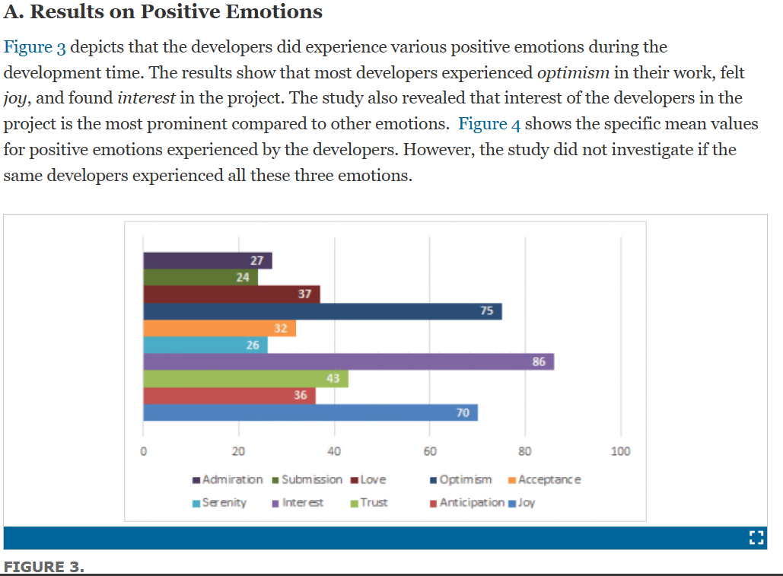
What happens when software developers are (un)happy - ScienceDirect
Lien humeur - qualité logiciel
Understanding the Impact of Emotions on the Quality of Software Artifacts | IEEE Journals & Magazine | IEEE Xplore

Slide 3

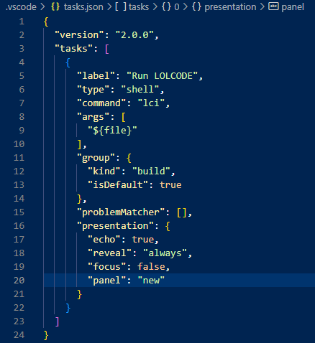
LOLCODE
Description
Syntaxe
Compilation

Slide 4
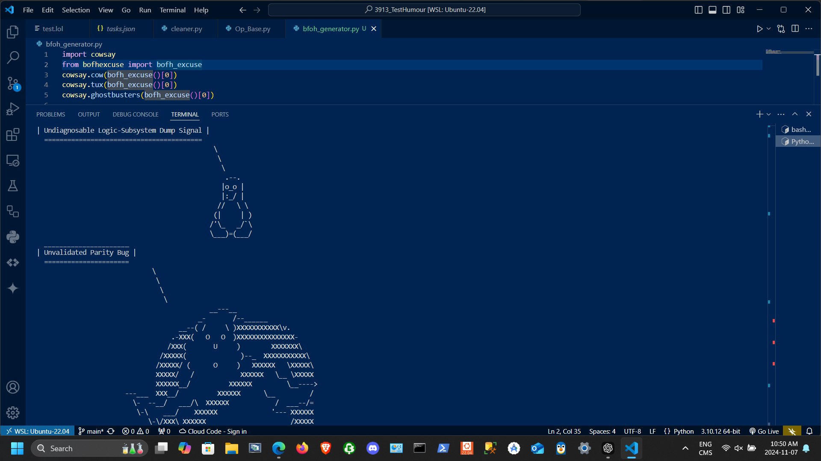
Cowsay
How To Use The cowsay Linux Command: An In-Depth 2500+ Word Guide – TheLinuxCode

Slide 5
Hollywood
Bipbiboup bip boup bip boup

Slide 6
Sources
Lolcode - Syntax
justinmeza/lci: A LOLCODE interpreter written in C.
cowsay · PyPI
giphy.com/gifs/funny-hacking-itsfoss-wmROp19pebs9W?utm_source=iframe&utm_medium=embed&utm_campaign=Embeds&utm_term=https%3A%2F%2Fitsfoss.com%2Fhollywood-hacker-screen%2F

